Slide 1
Using the Spanish Subjunctive

Slide 2
In order to know when to use the Subjunctive in Spanish, we can remember the word WEIRDO.

Slide 3
First, you should understand that the subjunctive ordinarily does not occur by itself. The subjunctive occurs after certain other verbs, called WEIRDO verbs.

Slide 4
Here Is How It Works
Queremos que ustedes vengan a la fiesta.
Ella espera que todos saquen buenas notas.
Insisto en que me escuches.
There are two verbs in each sentence
The first verb (in pink)
Forces the second verb (in blue) into the subjunctive

Slide 5
Here Is How It Works
Queremos que ustedes vengan a la fiesta.
Ella espera que todos saquen buenas notas.
Insisto en que me escuches.
PRO TIP
The Subjunctive comes after the word QUE
The first verb (in pink)
Forces the second verb (in blue) into the subjunctive

Slide 7
Here Is How It Works
Queremos que ustedes vengan a la fiesta.
Ella espera que todos saquen buenas notas.
Insisto en que me escuches.
PRO TIP
The Subjunctive comes after the word QUE

Slide 8
Here are the WEIRDO Verbs:

Slide 9
W is for Wishes & Wants
Wishes and Wants are expressed by a number of verbs in Spanish, but here are some of the most common:
Querer to want Necesitar to need
Esperar to wait Pedir to ask for
Desear to desire Preferir to prefer
Exigir to demand Mandar to order
Insistir to insist

Slide 10
W is for Wishes & Wants
Ana espera que su novio la invite a cenar.
Yo prefiero que llames después de las nueve.
Nadie quiere que los pobres sufran.

Slide 11
E is for Emotions
Here are some emotion verbs in Spanish:
Alegrarse to be happy Sentir to feel
Encantar to be delighted Temer to fear
Enojarse to be angry Gustar to like
Sorprender to surprise Lamentar to regret
Tener miedo to be afraid
You can also use Estar + emotion adjectives
Estar contento, alegre, triste, desilusionado, etc.

Slide 12
E is for Emotions
Yo estoy alegre que Laura no tenga problemas.
¿Te gusta que ellos traigan la música?
La Sra. Gallejo siente que todos no participen.

Slide 13
I is for Impersonal Expressions
Es + adjective phrases are known as impersonal expressions. There are hundreds of them, but here are a few common ones:
Es bueno Es malo Es curioso it is good it is bad it is curious
Es necesario Es triste Es importante
it is necessary it is sad it is important

Slide 14
I is for Impersonal Expressions
Es importante que prestes atención.
Es necesario que se porten bien en la escuela.
Es raro que Elena no quiera explicar.

Slide 15
R is for Recommendations
R is for recommendations, requirements, and requests. Here are some of these verbs:
Decir to tell Prohibir to prohibit
Rogar to beg Exigir to demand
Desear to desire Suplicar to plead
Sugerir to suggest Hacer to make / force
Recomendar to recommend

Slide 16
R is for Recommendations
¿Recomiendas que yo compre la bicicleta?
Yo sugiero que ustedes miren esa película.
La profesora diga que hagamos un proyecto.

Slide 17
D is for Doubt & Denial
D stands for doubt and denial. Here are some of these verbs:
Dudar to doubt
Negar to deny
No creer to not believe
No pensar to not think
No estar seguro to not be sure
No suponer to suppose not

Slide 18
D is for Doubt & Denial
Yo dudo que Marcos venga a tiempo.
Amanda niega que salga con Mario.
Nosotros no pensamos que ellos hagan las paces.

Slide 19
O is for Ojalá
Ojalá is a Spanish expression which means I wish, I hope, or It would be nice.
It comes from Arabic originally where it meant “May God grant.”
It is not a verb so you cannot conjugate it.
Others – As you continue your study of Spanish, you will learn more ways that the subjunctive can be used.

Slide 20
O is for Ojalá
Ojalá que haga sol.
Ojalá que tengamos suficiente tiempo.
Ojalá que haya sillas.

Slide 21
REVIEW
W E I R D O

Slide 22
REVIEW
W
Wishes and Wants

Slide 23
E
Emotions

Slide 24
I
Impersonal Expressions

Slide 25
R
Recommendations
Requests
Requirements

Slide 26
D
Doubts and Denials

Slide 27
O
Ojalá

Slide 28
I M P O R T A N T E
The word que holds everything together.
Necesito que tú escuches bien.
The first verb (in pink) is the WEIRDO verb.
The second verb
(in blue) is in the subjunctive

Slide 29
Adiós

Slide 30
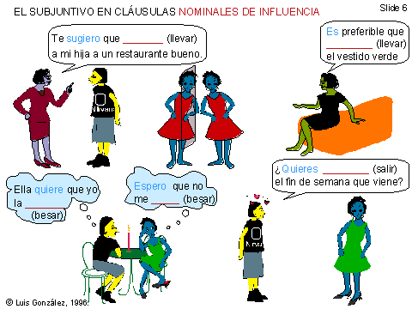

Slide 31
l
Y

